Slide 1
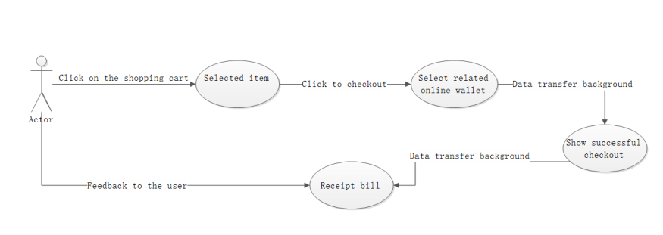
How to settle in the shopping cart of the website
The shopping cart checkout is divided into multiple operating units and multiple operating processes, which are individual, system operation, and background management. However, as the settlement method of the rental system, the function of selecting the rental duration is more than the ordinary settlement method. All the settlement methods on the Sias campus rental website have become
1. Select related products to add to the shopping cart
2. Click the shopping cart button
3. Selected billing item
4. Click OK to settle
5. Use the relevant online wallet to settle
6. Successful settlement, feedback credentials. Next let us enter the actual operation interface

Slide 2
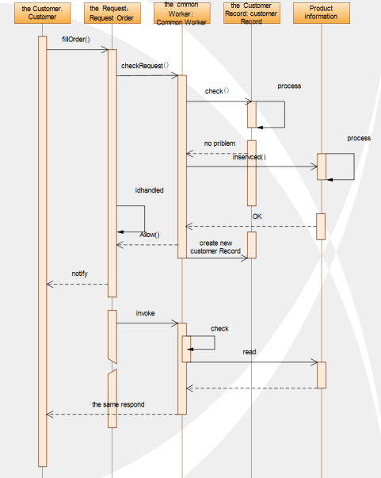
How to settle in the shopping cart of the website
This is the timing diagram of how the system background is processed.
When the user goes to operate the shopping cart to purchase, part of the system's background operation is realized. For example, adding a new customer transaction information, feedback on whether the electronic application form is approved, how the user knows how his user record is. Checked.

